Slide 1
Building the Future
Paul Griffiths
Chief Executive Officer
Dubai Airports
© Dubai Airports 2014
Notes:
Conference in London a couple of weeks back
Sir Howard Davies, Chairman of the Airports Commission, presented his thoughts on the options for expansion of London’s airports
It was an excellent, balanced and well-considered presentation
An observation which was shared by one journalist, who posed a rather important question
Maplin Sands – 1971 Cancelled 1974
Heathrow R3 – 2003 Cancelled 2010
Stansted G2 – 2008 Cancelled 2010
Sir Howard Davies Report – begun in 2012 Outcome ???
My subject for today is Building the future
Building not ‘Talking about Building’
Because here in Dubai that’s what we do

Slide 2
Dubai International
International Passenger Ranking
1993: 44th
2014: 1st ?
© Dubai Airports 2014
Notes:
After speaking I was followed by Willie Walsh, CEO of IAG
An Irishman doing excellent work overseas
But sadly not yet recognised by the Irish Government
Interestingly Willie spent some considerable time talking about Dubai
After all it’s the second largest route out of Heathrow after New York
Willie said that 10 years ago, no one would have believed that Dubai, then the 44th largest international airport in the world, would progress up the ranks so fast that in 2014 it would have its sights set on the No 1 spot

Slide 3
71.8 Million
International Passengers (Forecast 2014)
© Dubai Airports 2014
Notes:
In a year when one of our runways was out of service for 80 days and we lost 32% of our capacity
We project to end the year with nearly 72m passengers projected for 2014, an increase of 9.2%
Our sights are set on the inevitable outcome of overtaking Heathrow’s position as the world’s busiest international airport
So, building, not talking
An unwavering vision to build not just an airport but an engine of economic growth
Vital to the growth of the city
But…… we all recall the perilous days of just a few years ago
When the wheels came off the global economy
An everyone thought Dubai would falter.
So, what did we do, when development capital became scarce?
Embarked on an ambitious programme to increase the capacity of Dubai International by 50% within the same footprint

Slide 4
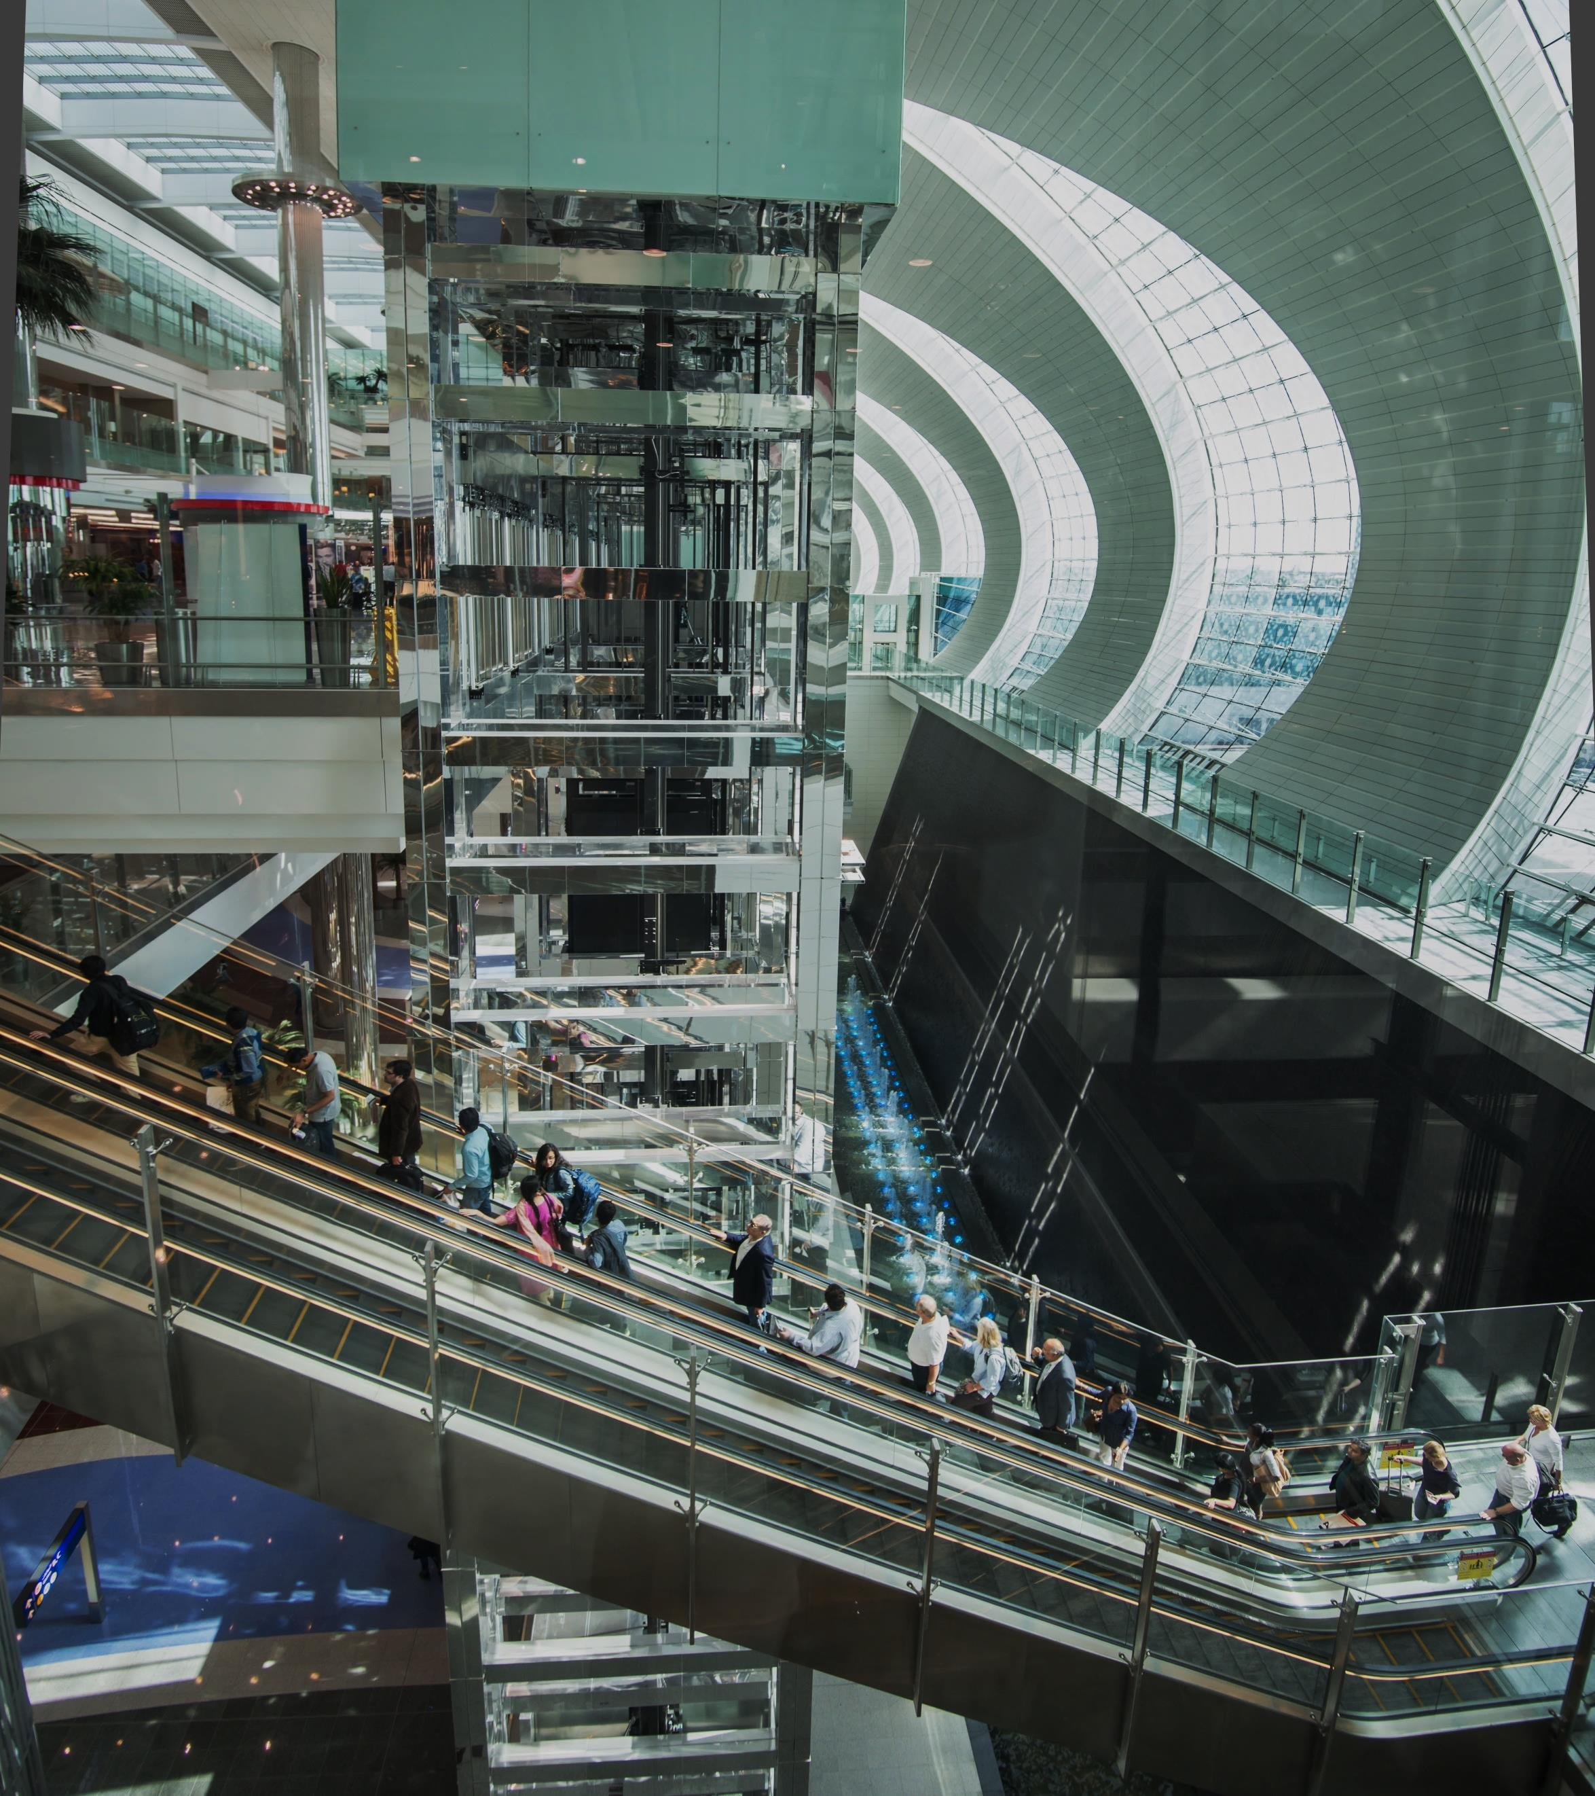
Dubai International:
Adapt and Grow
© Dubai Airports 2014
Notes:
Because for too long in the airport business
People associate capacity with space
And the ability to do anything more needs costly infrastructure
But at the time we had neither the time, or the space to build
So the intelligent solution was a hybrid solution of incremental capacity coupled with a dramatic increase in processing and flow rates
To bring capacity up from 60m to 90m by 2018
And we are well on track in fulfilling our mission to never constrain the growth of aviation here in Dubai

Slide 5
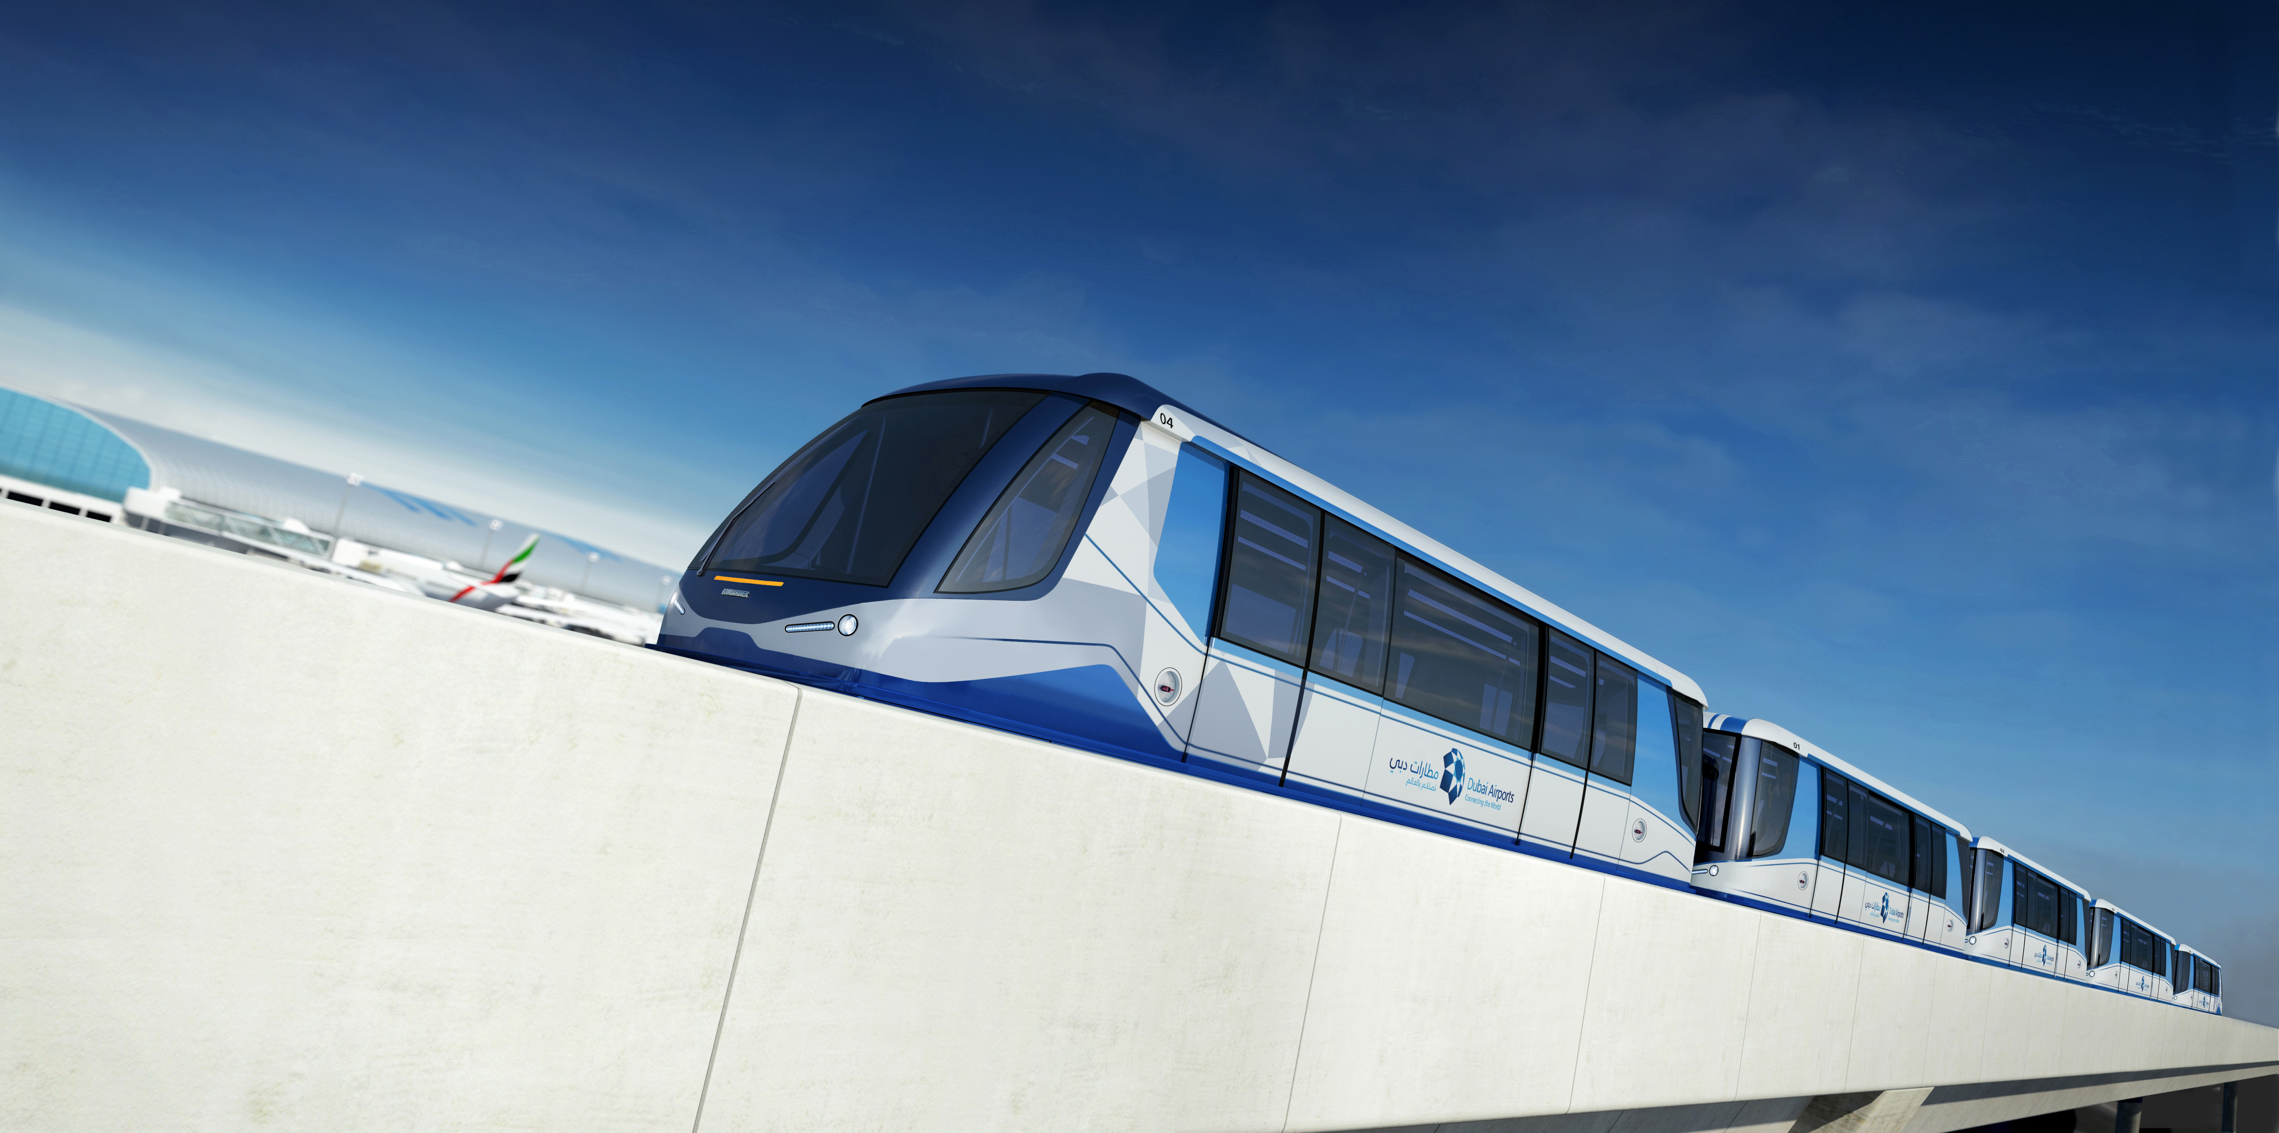
Dubai International:
Concourse D (2015)
Final stage of US$7.8bn investment programme
© Dubai Airports 2014
Notes:
The final piece of hitherto undeveloped infrastructure space within the airport is nearing completion
In 2015 we open Concourse D, home to our overseas airline partners
The zenith of our USD 7.8m SP2020 development programme
17 additional gates, 15m passengers, linked to T1 via APM
Of course we need to keep pushing the upper limits of DXB capacity
And parallel developments of additional remote stands and airspace efficiency
Will help push out as far as possible the point at which DXB becomes ex-growth
And without the availability of further infrastructure development or space to build it
We will have to come up with more intellectual, non-build solutions to satisfy Dubai’s continued thirst for growth
But fortunately, mankind remains a natural curious species and all around us the boundaries of human endeavour continue to be pushed

Slide 6
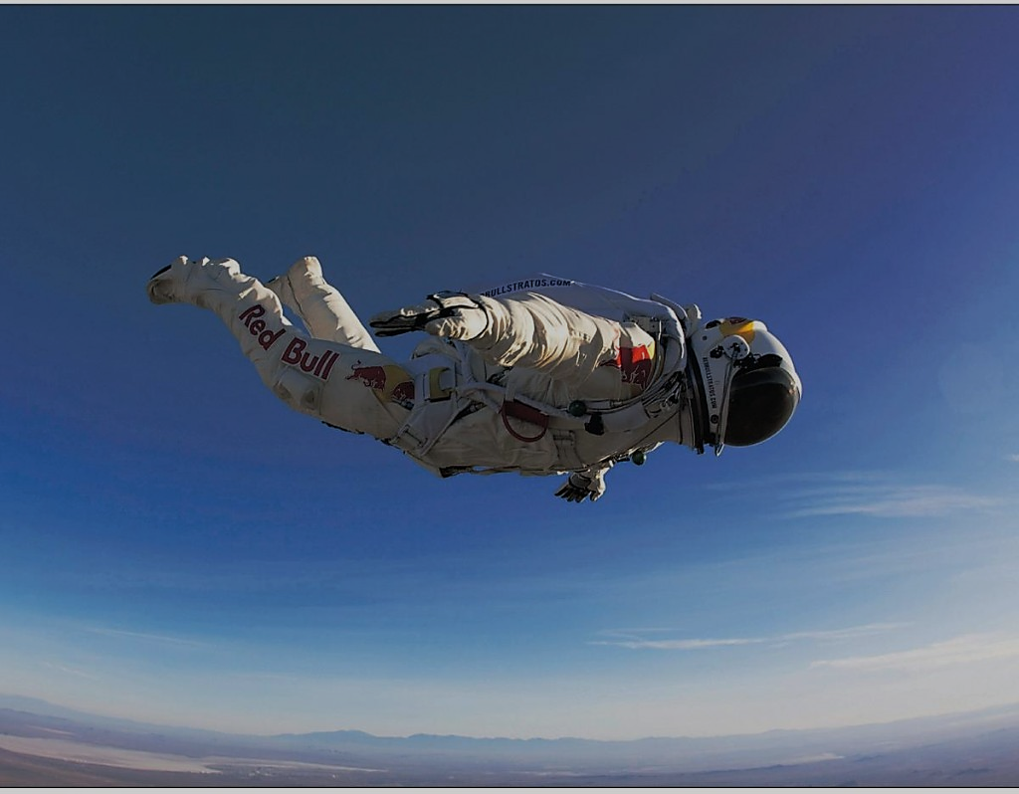
© Dubai Airports 2014
Notes:
On 14th October 2012, we all gasped when a 43 year old Austrian jumped out of his capsule 39km above the earth and landed safely after reaching a speed of 1,357.64 km/h on the way down.
So, as an illustration of the increasing appetite to push the boundaries of human endeavour, Felix Baumgartner’s record-breaking jump is a remarkable feat.
Just as remarkable is the major sponsor, another Austrian endeavour. One of the world’s most recognisable brands, Red Bull is only 27 years old and has a value of US$7.5bn
You’d imagine that Felix Baumgartner’s amazing record-breaking jump and Red Bull’s increased brand equity would be safe for a while……….

Slide 7
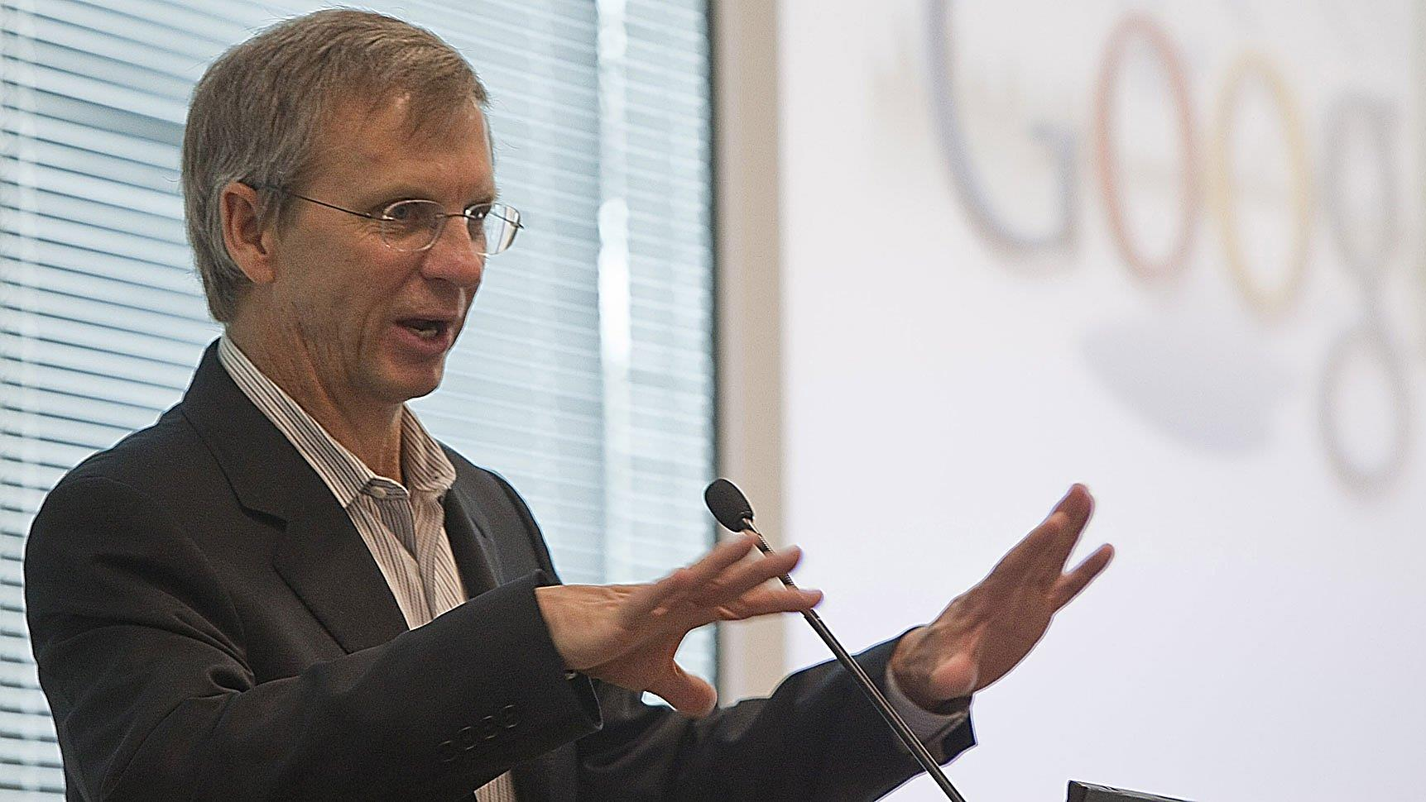
© Dubai Airports 2014
Notes:
So, where does this guy come in? Who is he?
Looks like a finance director of a regional accounting practice…….
Or a dentist, tax collector or manager of the local hardware store
Or maybe some bloke that runs Abu Dhabi Duty Free?
You’d expect him to drive a conservatively-branded car to his comfortable home in surburbia, to walk in the woods with his labrador at the weekends and to be suspicious of the internet.
But this just goes to show how looks can deceive.
Meet Alan Eustace, Senior Vice President of Knowledge at Google. That sounds impressive enough, but it’s what he does outside of his day job that is sure to impress.
On 24th October 2014, 57-year old Alan jumped from a balloon at a distance of 41.42kms above the earth, nearly 2.5kms higher than Felix Baumgartner’s previous record.
Unlike Baumgartner, Alan was not widely known as a daredevil prior to his jump
The pace of human endeavour is quickening - and it’s being pioneered in some unlikely ways.

Slide 8
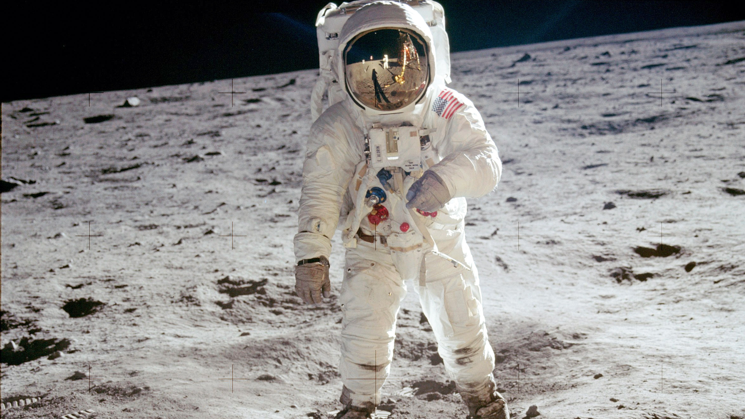
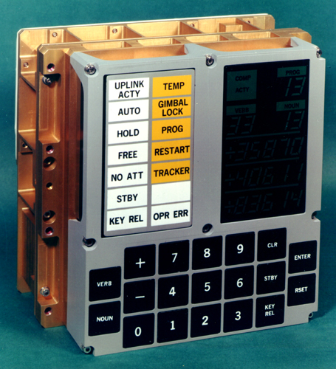
Apollo Guidance Computer (AGC)
Dimensions: 24 x 12.5 x 6.5 inches Weight: 70 pounds Processor speed: 1 MHz Memory: 2,048 words (32,768 bits or roughly 4kB) Display: Seven-segment numeric Price: $150,000 (est.)
© Dubai Airports 2014
Notes:
In July 1969, another major human milestone was passed when man first set foot on a world other than the one he had inhabited for thousands of years
The fragile machine that took him there was guided by a computer that weighed 70 pounds, cost $150,000 at 1969 prices (nearly $1m today) and had less computing power than a domestic coffee maker

Slide 9
Apple iPhone 5s
Dimensions: 4.87 inches x 2.31 inches Weight: 3.95 ounces Processor speed: 1.3GHz, dual-core Memory: 64GB Display: 4-inch diagonal Multi-Touch display, 1136 x 640 pixel resolution at 326 ppi Price: $399
© Dubai Airports 2014
Notes:
Take what’s in your pockets today.
Compared to the Apollo Guidance Computer, the average smartphone has;
16m times more memory capacity
Is 1,300 times faster
Is 0.3% of the weight
Is 0.04% of the cost
Small wonder then that 22% of global population now has a smartphone
In 2009 the number was 9%
There is one smartphone for every 4.5 people on earth
In the UAE, smartphone penetration is now 78%, easily one of the highest smartphone penetration rates in the region.
81 percent of mobile owners age 16-34 now own smartphones
The penetration is rising steadily among other age groups as well
The increasing capability and tumbling cost of technology is placing the sort of processing power unimaginable within our lifetimes in the pockets of billions of people.
And what is now happening is that the need to engineer hard wired process and technology into the infrastructure that makes up our airports of today is disappearing fast

Slide 10
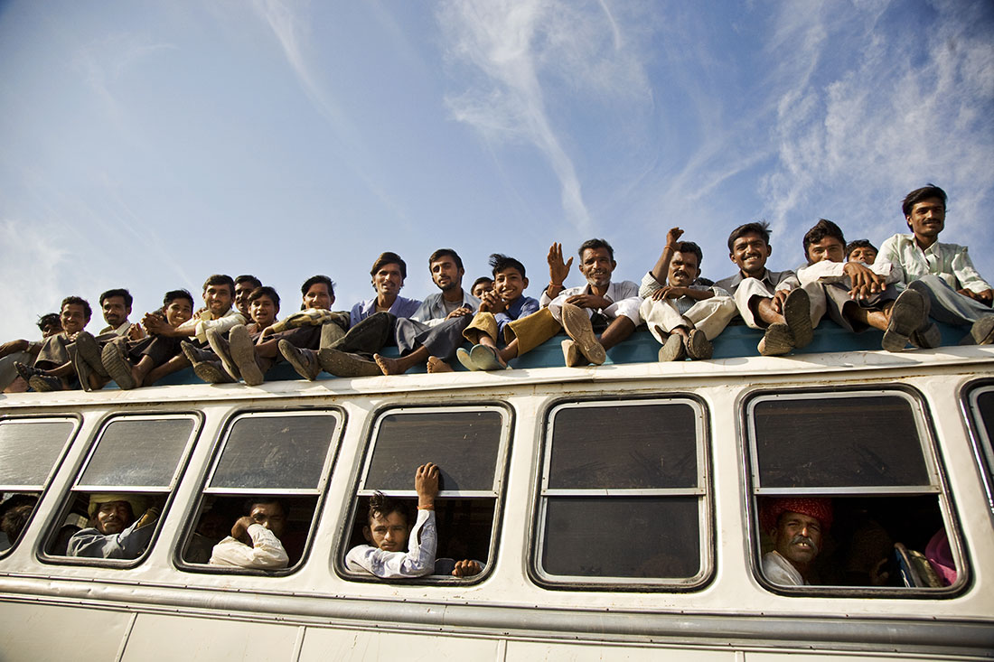
© Dubai Airports 2014
Notes:
In the future, our capacity problems will not be linked exclusively to the physical shortcomings of our hard infrastructure
We are on the cusp of a revolution, a transfer of power to the people.
The future of physical check-in, security, immigration and retailing lies in the palm of the hand of our customers
And that will revolutionise the way we think about infrastructure in the future.
We have to be innovative at DXB to counter the lack of space to develop more passenger capacity
And service, process and technical innovation will not only drive the future of DXB and keep us from running out of capacity in the near future, but will drive a strategy of customer-centric service innovation in the future
That’s not an option to be debated – because what we are planning to do with airport capacity in Dubai is not an evolution, it’s a revolution

Slide 11
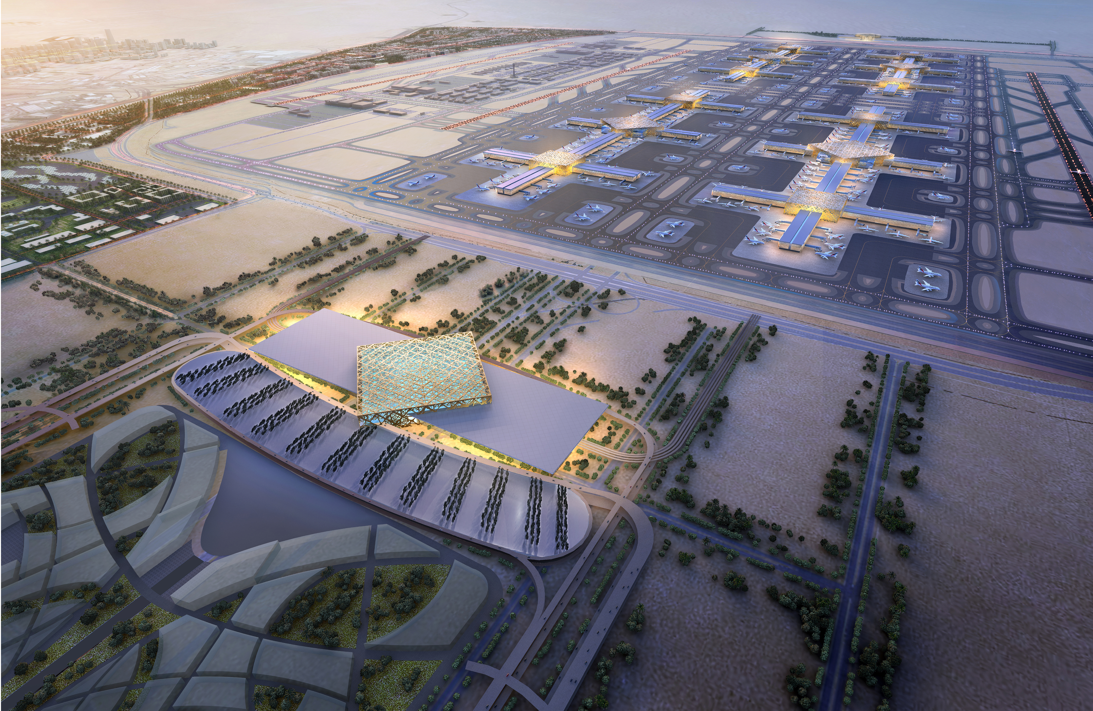
DWC
Think Big, Think Different
© Dubai Airports 2014
Notes:
Situated on a 140sq km site to the south of Dubai
10 times larger than the site of DXB
Unprecedented scale – but this of itself brings challenges
The world’s largest airport, the worlds largest intercontinental hub
We don’t want the world’s longest walking distances, the world’s most daunting and impersonal airport experience
So this has to be thought of in a completely different way

Slide 12
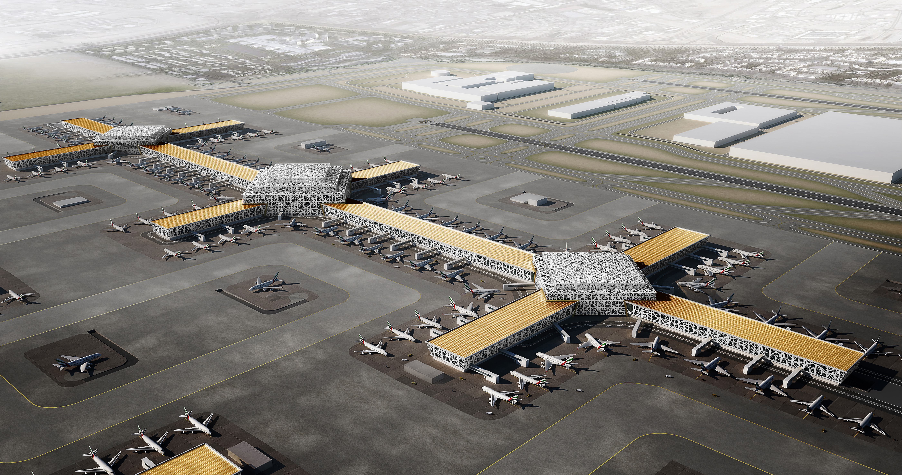
DWC Capacity:
120 million, to 240 million
© Dubai Airports 2014
Notes:
The initial phase of Dubai World Central – Al Maktoum International is planned for the first half of the next decade with an initial capacity of 120m passengers
Its primary role will be to accommodate the Emirates hub and is likely to become the exclusive home base for the airline.
Design challenges are focussed on four key areas
1. Passenger Experience
Walking distances – no more than 400m
Node connectivity – each node 20m passengers, each gate concourse 5m
Ease of way finding
Efficient passenger processing
Clustered Retailing & F&B at each node
2. Airline Product
MCT and passenger connectivity
Scaleable Capacity for incremental growth and ultimate capacity
Stand count to match demand and phasing
3. Airport Processes
- Stand / ramp operations to be efficient and ‘green’
- Baggage systems – speed and reliability
- Maximum efficiency Airfield operations
- Logistics and supply chain engineering
4. Facilities
- Construction cost and complexity
- Modularity and phasing

Slide 13
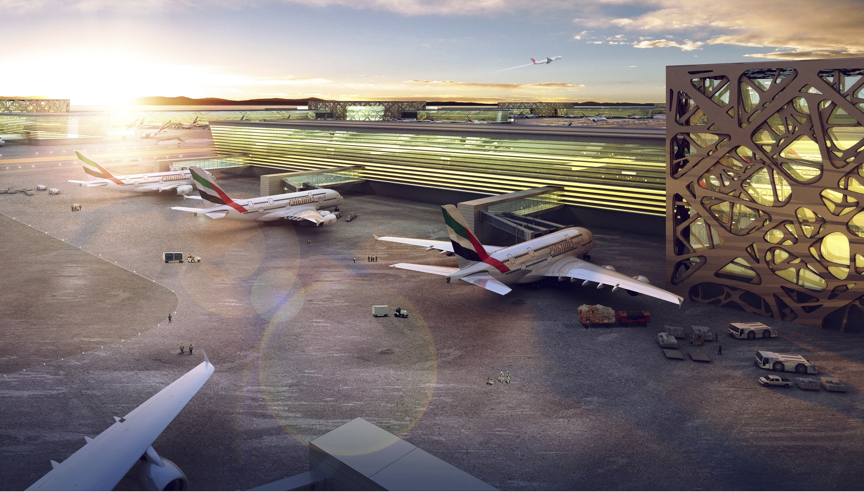
DWC next phase:
$32 billion investment
© Dubai Airports 2014
Notes:
And of course all of this has to be accompanied by a new commercial model
The next phase to get us to 120m passengers is projected to cost US$ 32bn
And of course we have to spend all of that money before a single additional passenger passes through the airport
We’re not alone - together with other government infrastructure projects, the total funding requirements is just short of US$ 100bn
The scale is such that funding will have to be supported by strong commercial performance within the aviation sector
A robust return on invested capital will have to be demonstrated
We will be increasingly looking outside for assistance and will need to maximise our utilisation of space, our costs of infrastructure, our spend per passenger
We will need to minimise our construction, operating, maintenance and energy costs with repeatable, space efficient design, with renewable and sustainable energy policies
This will all require some innovative thinking, backed by the latest innovations in science and technology, all combining to produce an airport experience that represents the next level in service and convenience
So, we’ll be looking for ideas, for partnerships and for new ways of working in order to secure our vision of the future.

Slide 14
Contribution to Dubai’s economy
2013:
$26.7 billion (27%)
416,500 jobs (21%)
© Dubai Airports 2014
Notes:
But the fundamentals are strong
In 2013, aviation contributed US$ 26.7bn to the economy of Dubai
That’s 27% of GDP
And 416,500 people rely on aviation activities for the livelihood
That’s 27% of the workforce in Dubai

Slide 15
Contribution to Dubai’s economy
2030:
$88.1 bn (44.7%) ,
1,194,700 jobs (35.1%)
© Dubai Airports 2014
Notes:
And the vision for aviation remains single minded and utterly focussed on building that contribution at a faster rate than any other activity in Dubai
By 2030, the contribution to the economy of Dubai will have increased to US$88bn, more than 3 times the 2013 figure
An increase of 17 percentage points over the 2013 number to 44.7% of GDP
With more than 1.1m people pursuing their careers in sector related fields
By then more than 1 in 3 of the workforce will be in an aviation-related job
And those jobs will be oriented around facilitating passenger journeys, using the latest technology and customer-enabling processes
But all of these incredible facts and figures rely on one single and unwaverring factor
That is the clear and determined vision, unchanged for over 50 years, to create an aviation enterprise with the world’s greatest airports, hosting the world’s greatest airlines, in the world’s greatest city.

Slide 16
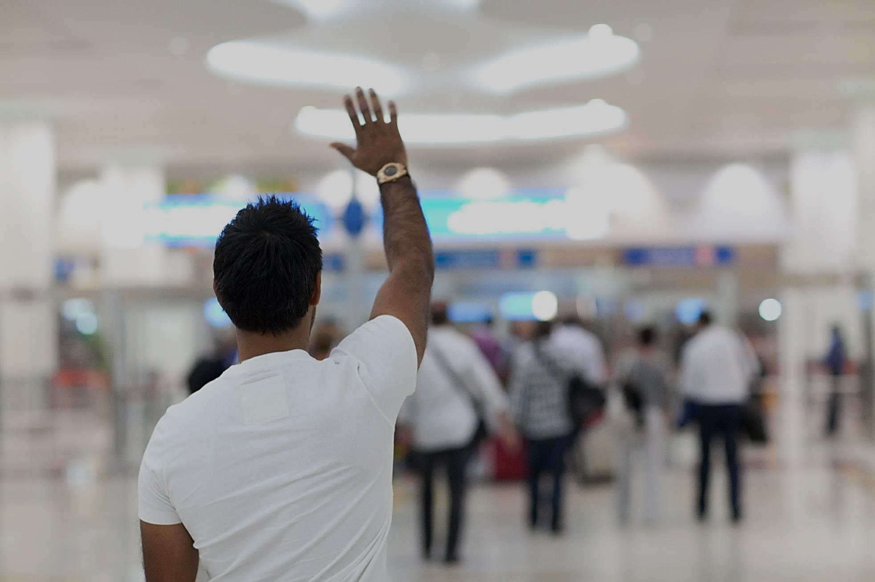
Thank you
paul.griffiths@dubaiairports.ae
paul.griffiths@dubaiairports.ae
© Dubai Airports 2014
© Dubai Airports 2014
Notes:
And , as for my friends in other parts of the world
For sure they will still be talking
And waving goodbye to their former dominance in global aviation
For ever.
Thanks for listening

